Slide 1
Group Project Prototype AllergenAware
Group 3
Emily Gaddis
Marya Al Bakshi
Matthew Mattera
Austin Newhouse

Slide 2
Emblematic Problem Scenario
Nate Anderson went to Champs Bar and Grill, but unknown to him, Champs has recently had numerous cases of cross-contamination. Unfortunately for Nate, the dish he ordered was contaminated with shellfish, something he was severely allergic to. He was rushed to the hospital after having a severe reaction which required immediate medical support.
Notes:
Matt

Slide 3
Solution
AllergenAware is a social media app that allows users with allergies to report their findings on the allergy awareness that certain restaurants have.
On the app, users can post their reviews of a restaurant's food safety and see others' posts. A user can narrow their search by a particular allergy or a particular restaurant.
Users can also view each restaurant's page for more detailed information regarding their menu, as well as have their questions answered.
Notes:
Emily

Slide 4
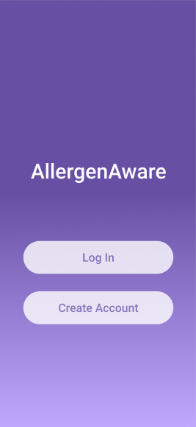
Login Option Page
This view displays the login screen. The user is given the option to either log in or create an account.

Slide 5
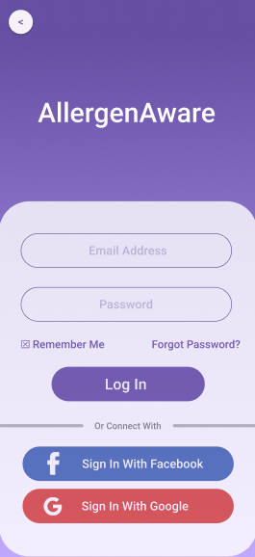
Login Page
This view displays 2 different ways to log In: using the user’s email address and password, or through Facebook / Google account information.

Slide 6
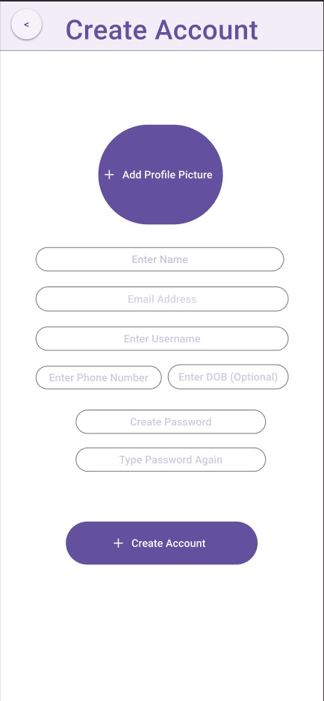
Create Account
This view allows the user to create an account for the app, providing their personal information. This allows the app to save data for a user, making the overall experience better.

Slide 7
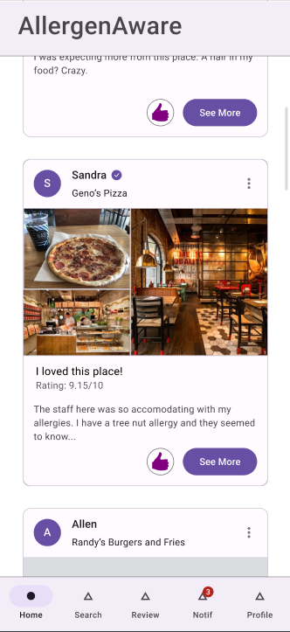
Home View
On this view, a user can see previews of others’ reviews of various restaurants nearby. This is a scrollable view. Each preview is condensed to fit many on this page. If a user desires to see more of the user’s review, they can click the “See More” button. Also, a user can like the review using the thumbs-up button.
From the taskbar at the bottom, the user can select from the search, review, notifications, and profile tabs.

Slide 8
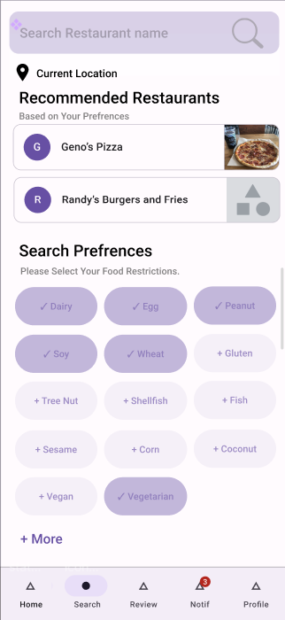
Search View
In this view, the user is presented with different ways to look for what they want. They can either look for a specific restaurant using the search bar in the top of the screen, or they can search based on their food restrictions shown in the middle to bottom half of the screen. Searching by preference filters out restaurants that do not accommodate or have replacements for the selected ingredients. Under the search bar, the user can select their location and recommended restaurants near the area will show up.

Slide 9
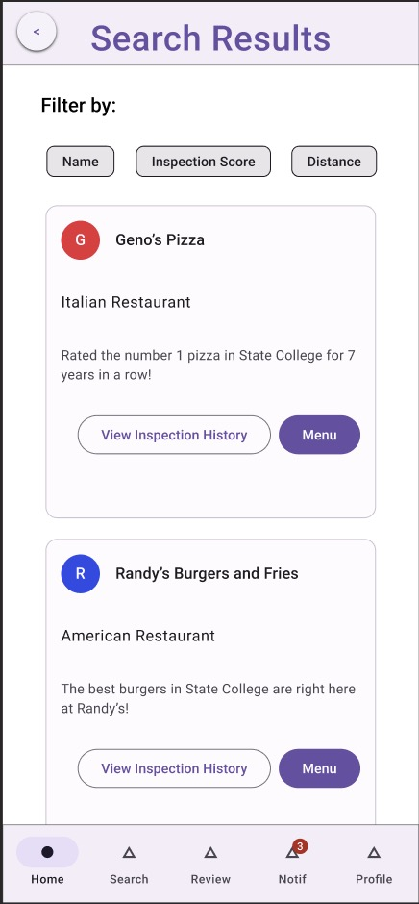
Search Results
This view displays the results of a search query. If offers the ability to sort by restaurant name, inspection scores, and current distance from users. This page is scrollable.

Slide 10
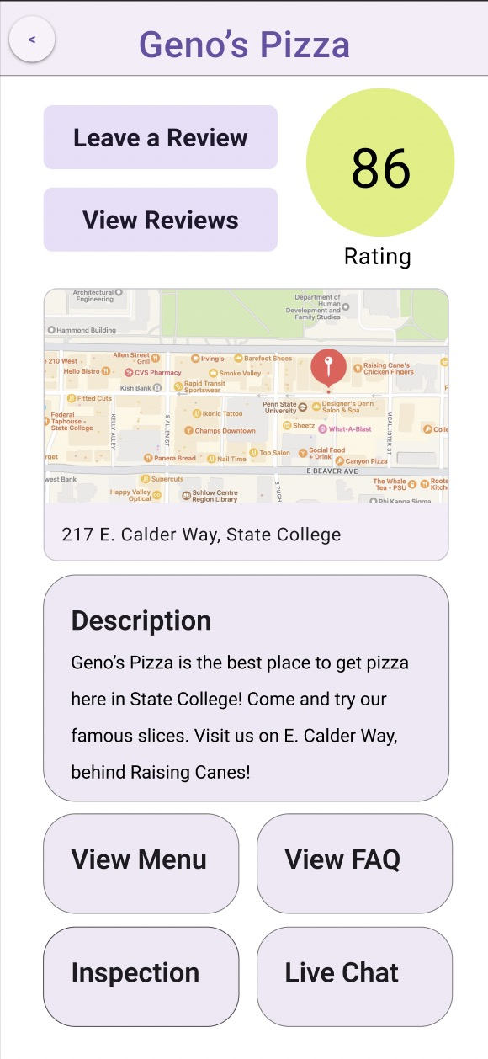
Restaurant View
This view displays all restaurant info, such as overall score and precise restaurant location. There are also buttons to direct the user to leave a review, view other reviews, view the menu, or view inspection scores.

Slide 11
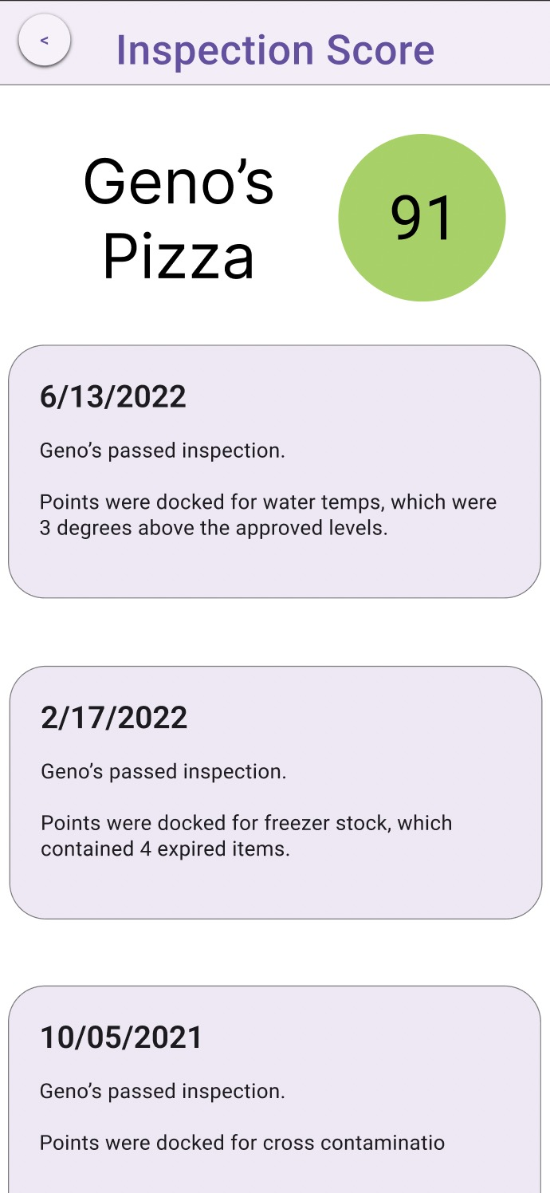
Inspection Page
This view displays the scores that a restaurant has received from the health department. The color of the circle represents the quality of the score. This page is scrollable.

Slide 12
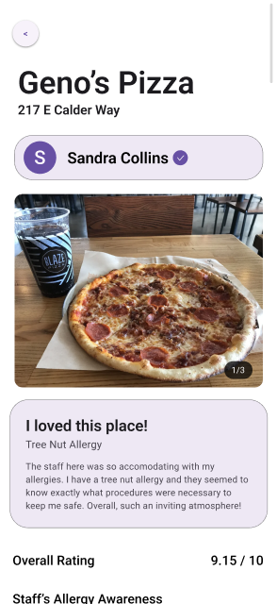
Review View
If a user clicks the “See More” button on the home view, it will redirect them here. This scrollable view allows the user to see another user’s complete review of a restaurant. This extends beyond the condensed version shown on the home view.
If the user keeps scrolling, they will see the ratings that the “Write a Review” view displays. The overall rating is an average of all the ratings they gave (the others are visible if the user scrolls down).

Slide 13
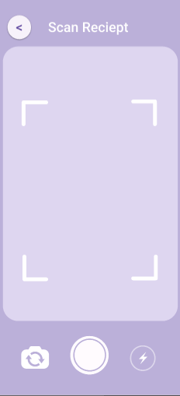
Scan View
The scan view allows the user to scan their receipt to add it to their review. In this view, the user is given the option to use their phone's flashlight if needed, and an upload button that takes them back to the review page with a scan of the receipt included.

Slide 14
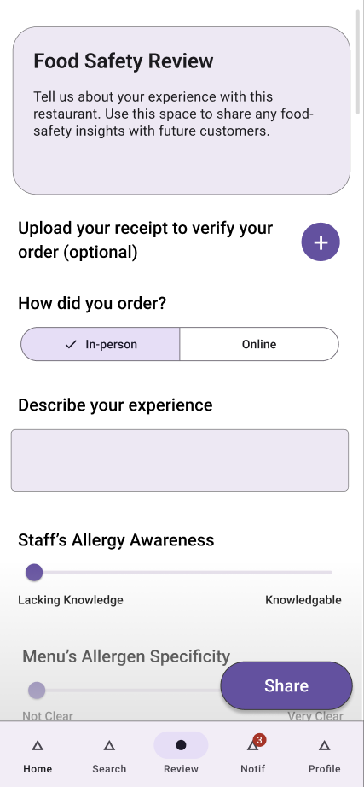
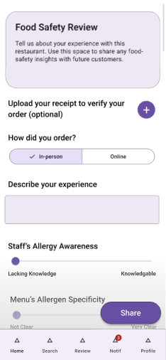
Write a Review
After the user scans their receipt, they will be redirected to this view. From here they can fill out this scrollable view to share their experience. Each toggle bar will be later shown as a percent on the completed review view.

Slide 15
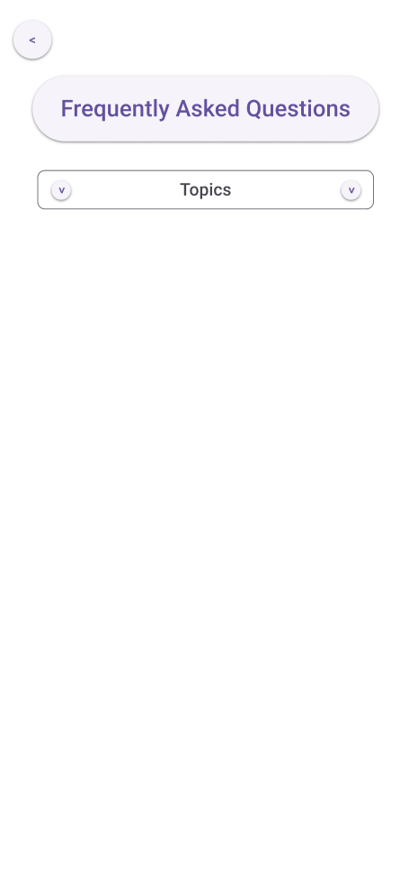
FAQ Main page
This is the landing page for the Frequently Asked Questions. From here users may use the dropdown to select what topics they need answers for.

Slide 16
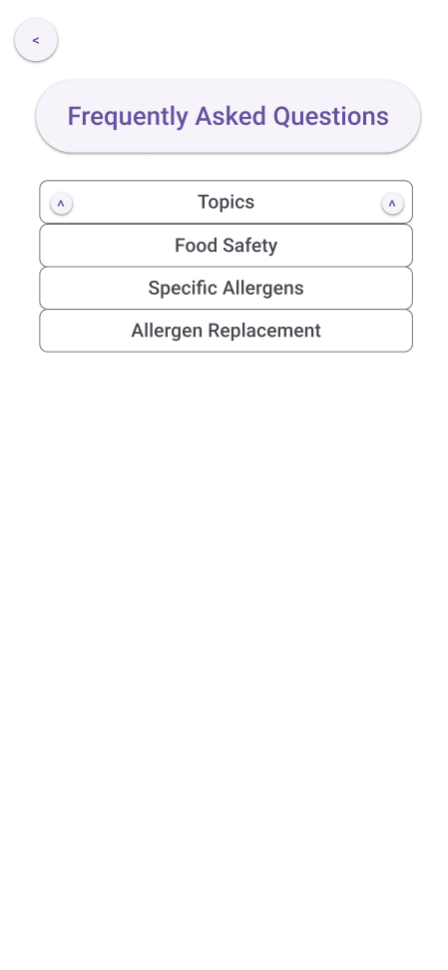
FAQ Expanded
This is the same page, just with the dropdown expanded for the user to select from.

Slide 17
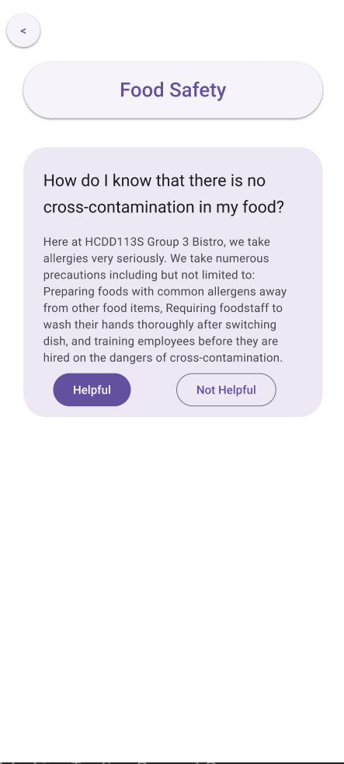
FAQ – Food Safety
This is the food safety section of the FAQs. This houses any FAQs that the owner posts that they believe pertains to food safety.

Slide 18
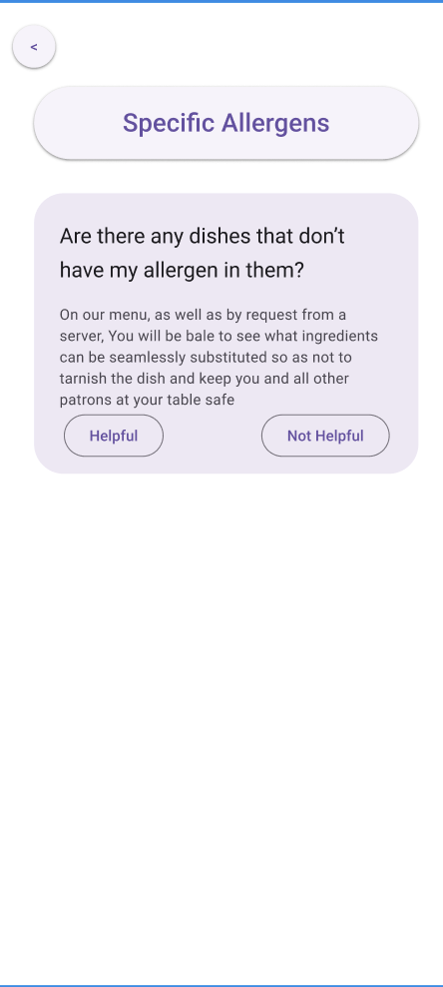
FAQ – Specific Allergens
This is the specific allergens section of the FAQs. This houses any FAQs that the owner posts that they believe pertains to people looking for information about specific allergens or individual allergens.

Slide 19
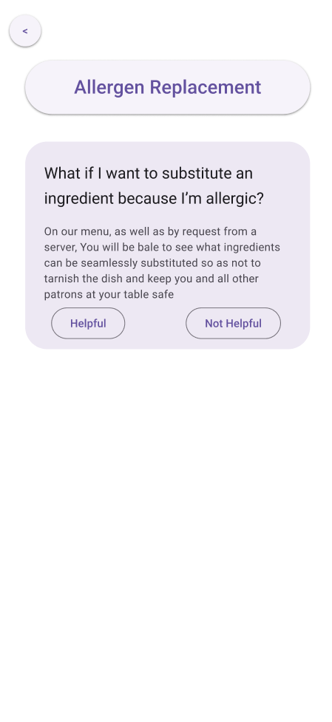
FAQ – Allergen replacement
This is the allergen replacement section of the FAQs. This houses any FAQs that the owner posts that they believe pertains to users aiming to replace ingredients that are allergens.

Slide 20
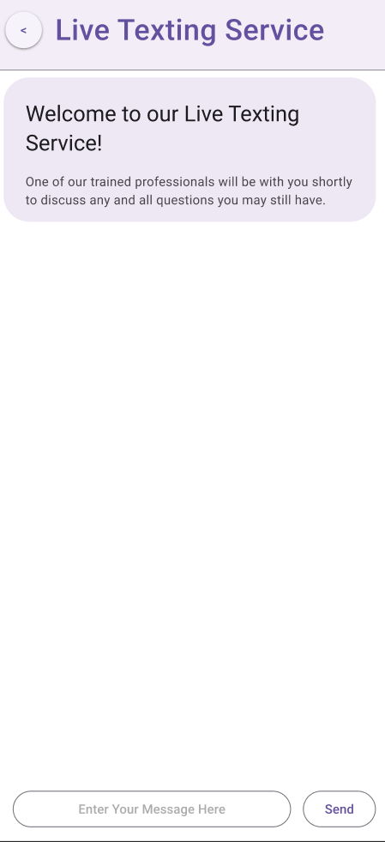
Live Chat - Main
This is the live help chat. This is for any users who couldn’t find the information they needed on the app/FAQ page.

Slide 21
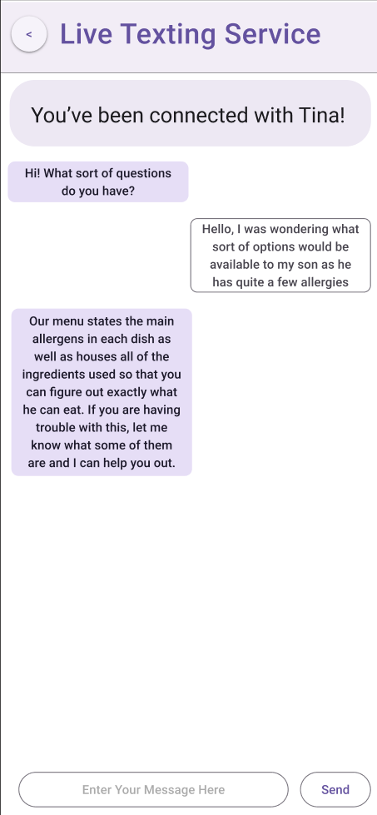
Live Chat with Text
This is the view after the chat has begun and someone has connected with the user to speak with them and answer their questions.

Slide 22
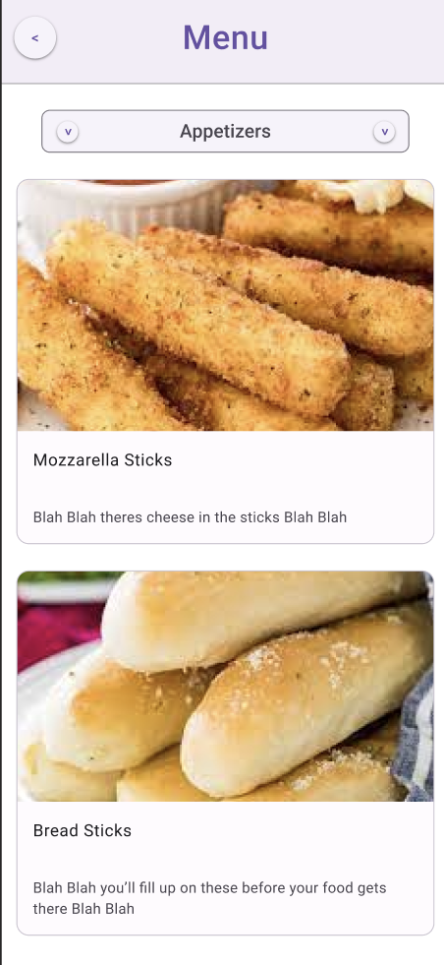
Menu, Appetizers
This is the appetizers section, showing the user all of the appetizers that are available to the user, as well as serving as the landing page for users viewing the menu.

Slide 23
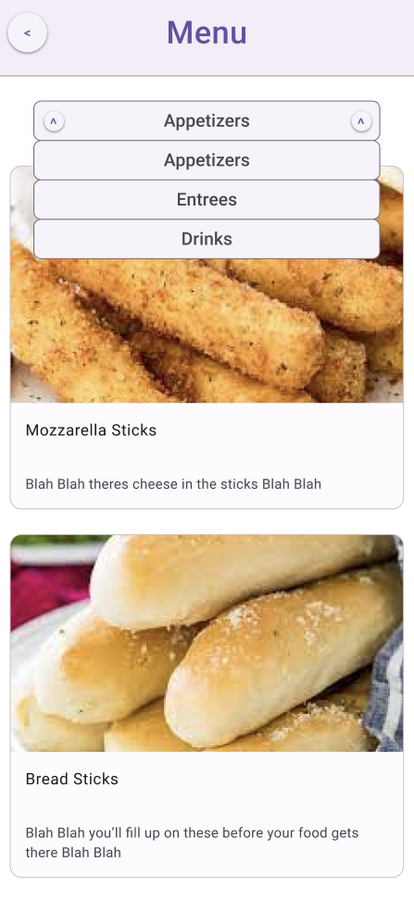
Menu, Appetizers, Expanded
This is the same page, just with the categories section dropped down to show the user their options.

Slide 24
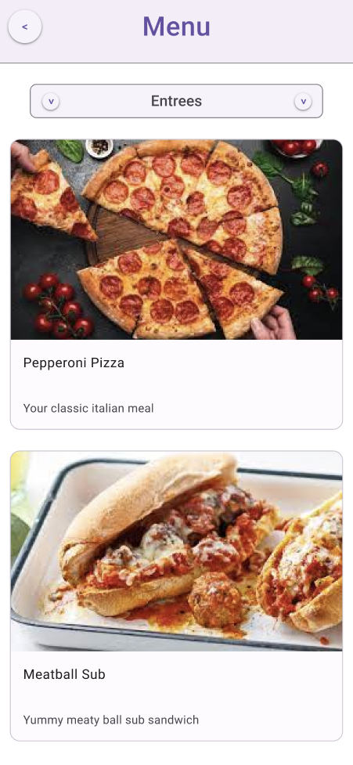
Menu, Entrees
This is the entrees section, showing the user all of the entrees that are available to the user.

Slide 25
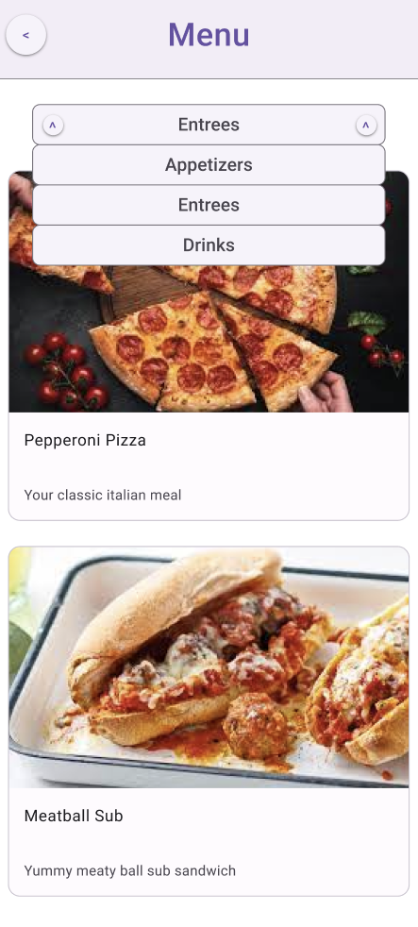
Menu, Entrees, Expanded
This is the same page, just with the categories section dropped down to show the user their options.

Slide 26
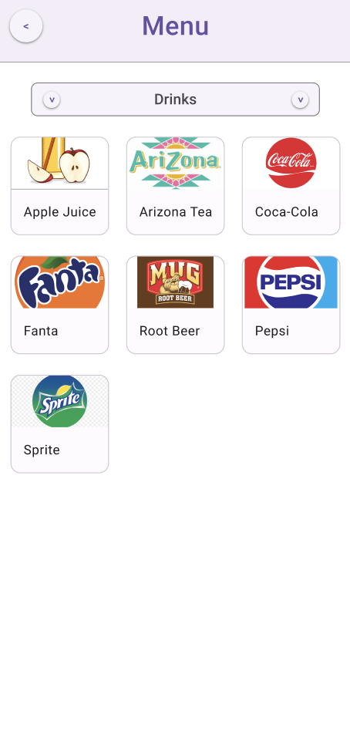
Menu, Drinks
This is the drinks section, showing the user all of the drinks that are available to the user.

Slide 27
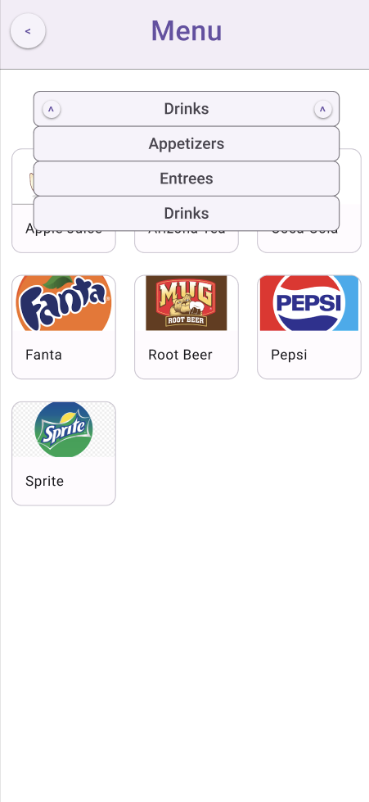
Menu, Drinks, Expanded
This is the same page, just with the categories section dropped down to show the user their options.

Slide 28
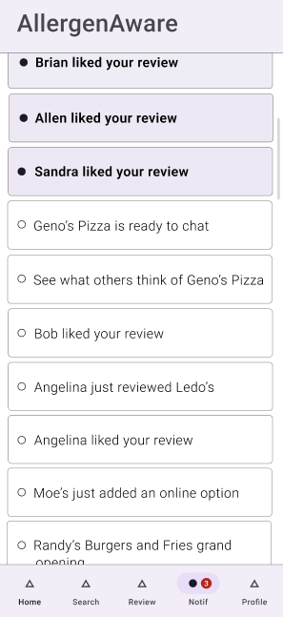
Notification View
Here, a user can see who has liked their reviews. Also, they can see additional information about restaurants and those who have interacted with their content.
On this view, the user has access to all other tabs on the taskbar.

Slide 29
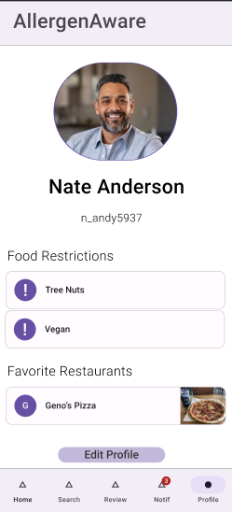
Profile View
After a user creates their account, it will show up here. A user’s profile photo, name, and username are displayed at the top. Their food restrictions and top-rated restaurant are displayed underneath this.
At any point, the user has the option to change any of this information.

Slide 30
Inspection Page
This view displays the scores that a restaurant has received from the health department. The color of the circle represents the quality of the score. This page is scrollable.

Slide 31
Restaurant View
This view displays all restaurant info, such as overall score and precise restaurant location. There are also buttons to direct the user to leave a review, view other reviews, view the menu, or view inspection scores.

Slide 32
Restaurant View
This view displays all restaurant info, such as overall score and precise restaurant location. There are also buttons to direct the user to leave a review, view other reviews, view the menu, or view inspection scores.

Slide 33
Evaluation Results
Matt's mom is vegan and eating at restaurants can prove to be a struggle for her. After using the app, she found it very beneficial in supporting her food needs. She could now look in advance at places nearby that could easily accommodate her without having to guess. In particular, she appreciated how straightforward the task bar was. The set up was like most other social media apps in this sense, making its use more efficient.
Chris stated that “This is something my family and I would for sure use.” He really enjoyed the concept as a whole, informing me multiple times that it was “f***ing sick”. He especially liked the live chat, the notification system (although he did find possible improvements for it detailed later), and the review system. While he did find some flaws and areas of improvement, he was overall quite pleased with it and has adamantly stated he would use it multiple times a week if brought to life.
Changes:
In the future, adding a "friends" component can increase a sense of community in AllergenAware's users, especially amongst those with similar allergies. People will be able to find friends from seeing their reviews on the home view, on the search view, and through a restaurant's review page.
Having friends can be useful in notification algorithms, that way notifications aren’t just random suggestions created by the app. Seeing relevant people pop up on user's notifications would make the app more enticing and engaging.
Also, by having a friend component, the home view's reviews can not only reflect restaurants nearby, but also the reviews that a user's friends have written.
Not only will you receive notifications from friends, and be able to view their reviews, but friends will also have the ability to recommend other restaurants to you and vice versa.
Notes:
AJ Top/Interviews
Marya Bottom/Changes

